Slide 1

Lecturer Claims Management System
PRog6212_P3:
ST10114043

Slide 2
PROBLEM AND SOLUTION:
Problem: Claims via spreadsheets and emails are slow, inconsistent, and hard to track.
Solution: A web app with role-based dashboards, secure uploads, and a transparent approval flow.
Presenter notes: Set context: we replace messy manual processes with a guided, role-aware workflow

Slide 3
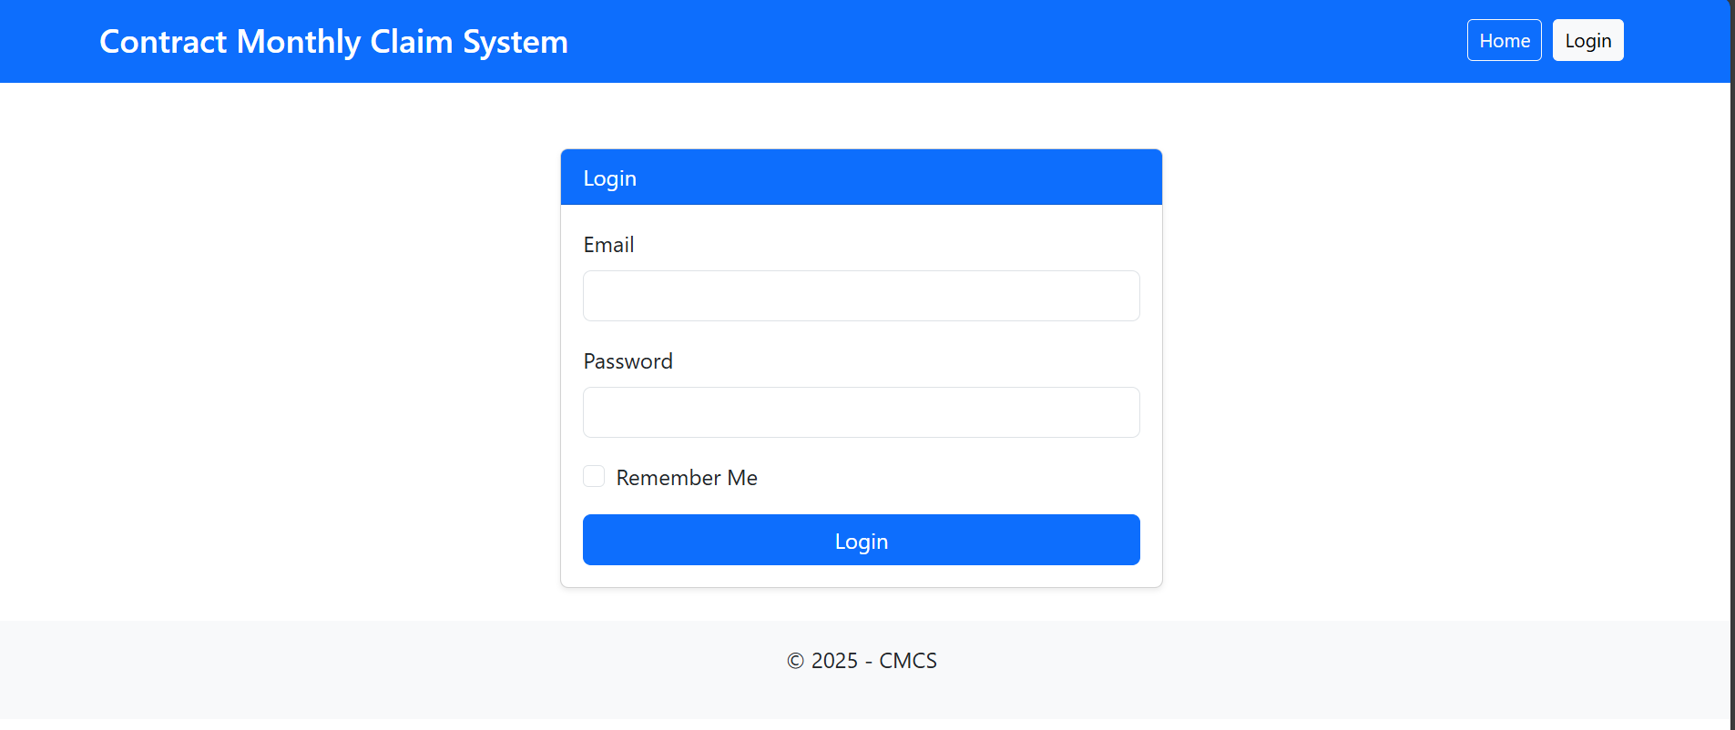
Notes:
Login Page of App

Slide 4
Slide 3: Scenario alignment
Scenario focus: Independent Contractor lecturers submit monthly claims; Programme Coordinators and Academic Managers verify/approve; HR manages users and emergencies.
Fit: CMCS matches this scenario: lecturers submit, coordinators verify, managers approve, HR oversees users and exceptions.
Workflow: Simple workflow diagram (Lecturer → Coordinator → Manager → HR).

Slide 5
Tech stack and architecture
Backend: ASP.NET Core MVC, Identity (role-based auth), EF Core with SQLite.
Frontend: Bootstrap 5 for clean, responsive layouts.
Storage: Claims + files persisted; encryption/decryption service for secure file handling.
Testing: xUnit coverage for core flows.

Slide 6
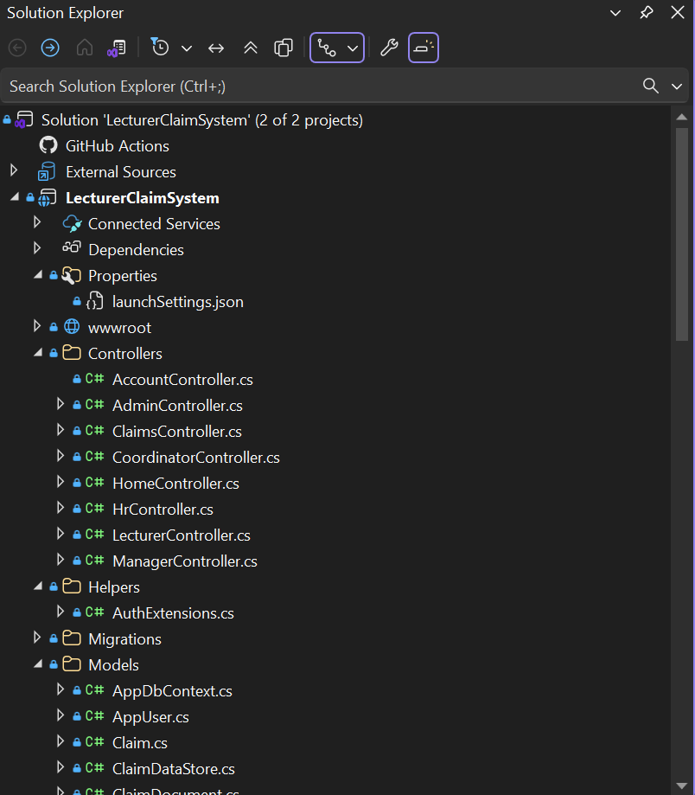

Slide 7
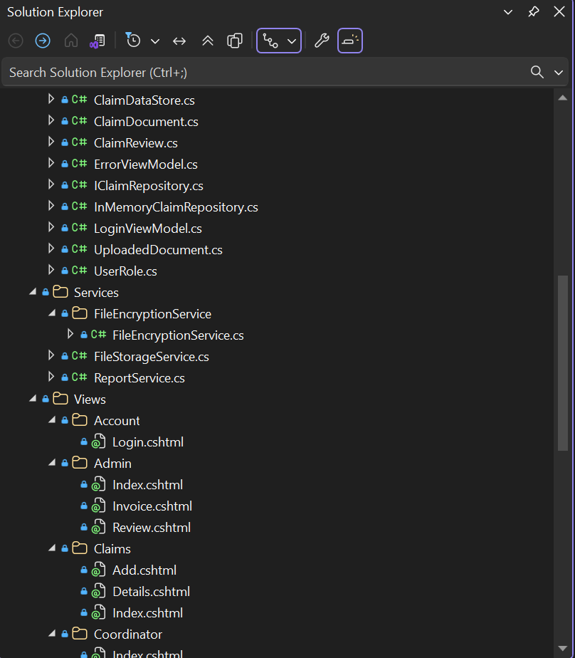

Slide 8
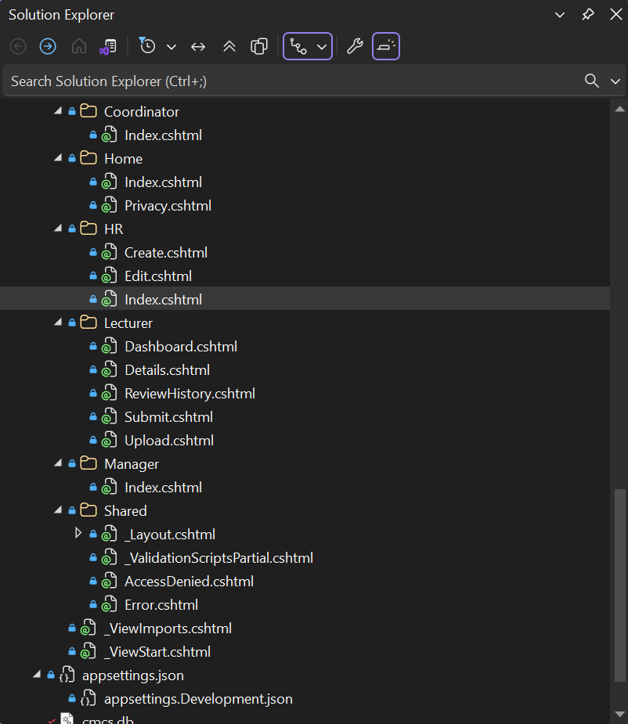
Notes:
Structure of program featuring models, views and controllers

Slide 9
HR first login and user management
Login flow: HR logs in first (hr@cms.local / Pass@123); lands directly on HR dashboard.
Control: HR creates, edits, and deletes users; assigns roles and hourly rates.
Access: Role-aware navigation limits visibility to what each role needs.

Slide 10
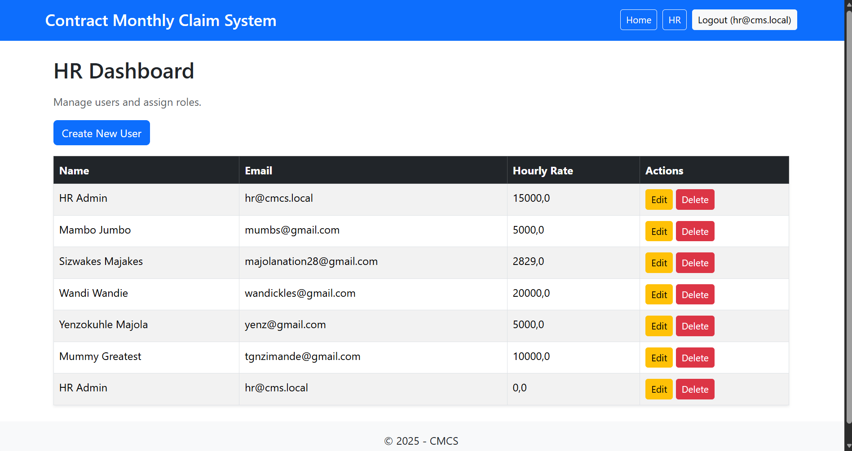
Notes:
Logging users onto System using HR Dashboard

Slide 11
Lecturer claim submission
Pulled data: Name, surname, hourly rate pulled from HR’s records — lecturer doesn’t set their own rate.
Auto-calculation: Earnings = hours × hourly rate shown live as hours are entered.
Validation: Guards for realistic monthly hours (e.g., 180-hour threshold).

Slide 12
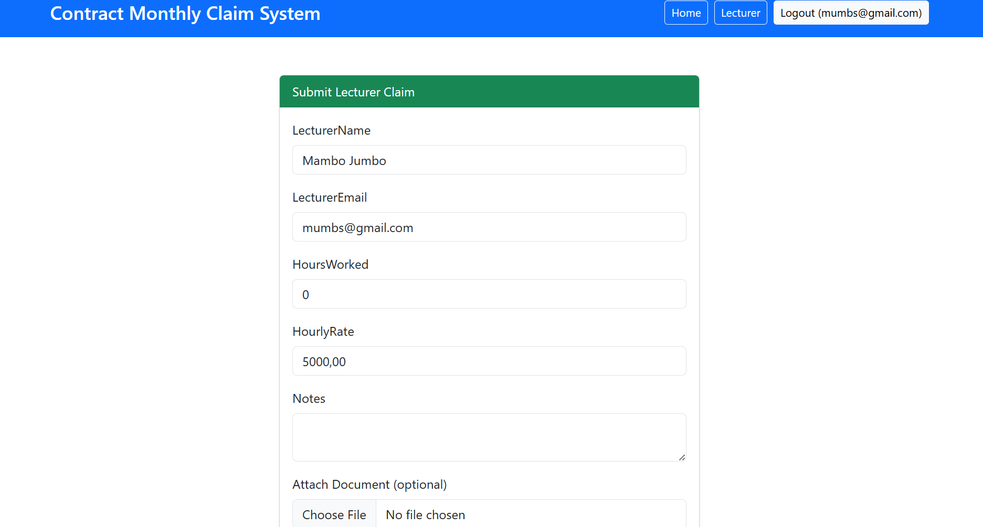
Notes:
Lecturer submission page

Slide 13
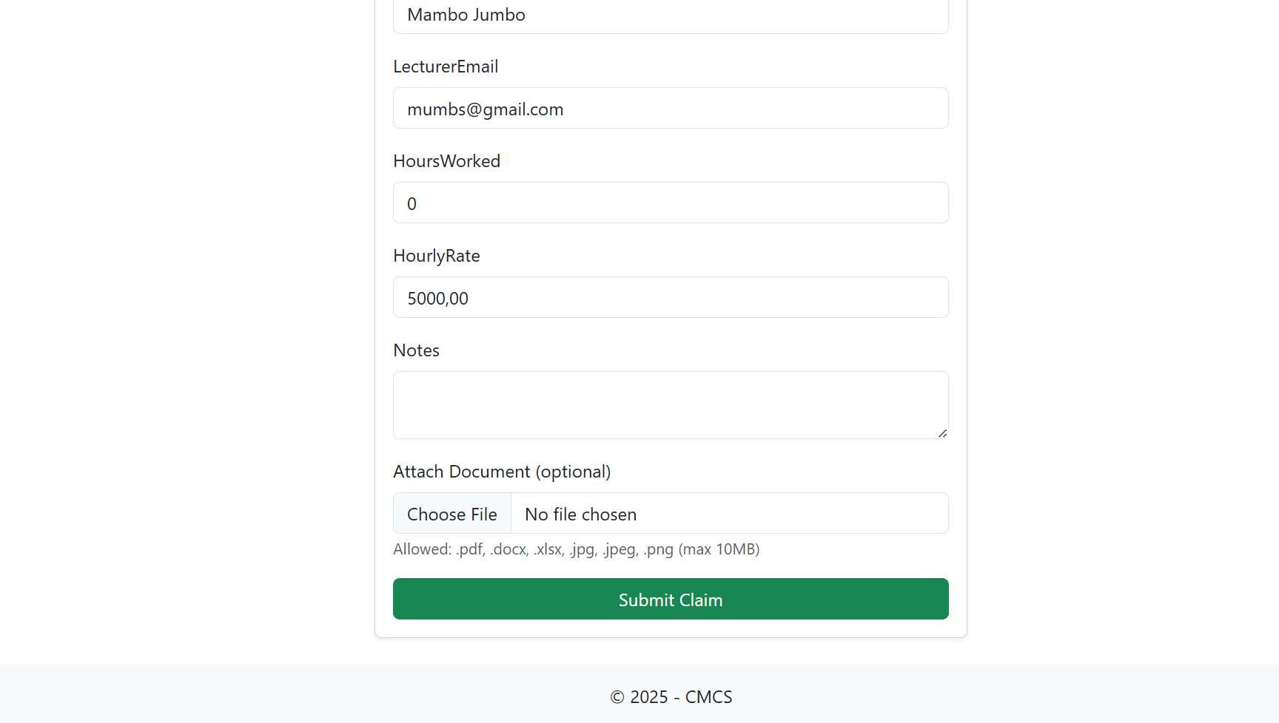
Notes:
Lecturer submission page

Slide 14
File handling and security
Upload: PDF, DOCX, XLSX (and images if needed) linked to the claim.
Security: Encryption/decryption service included for secure file handling.
Feedback: Clear success/error messages; file name displayed on form.

Slide 15
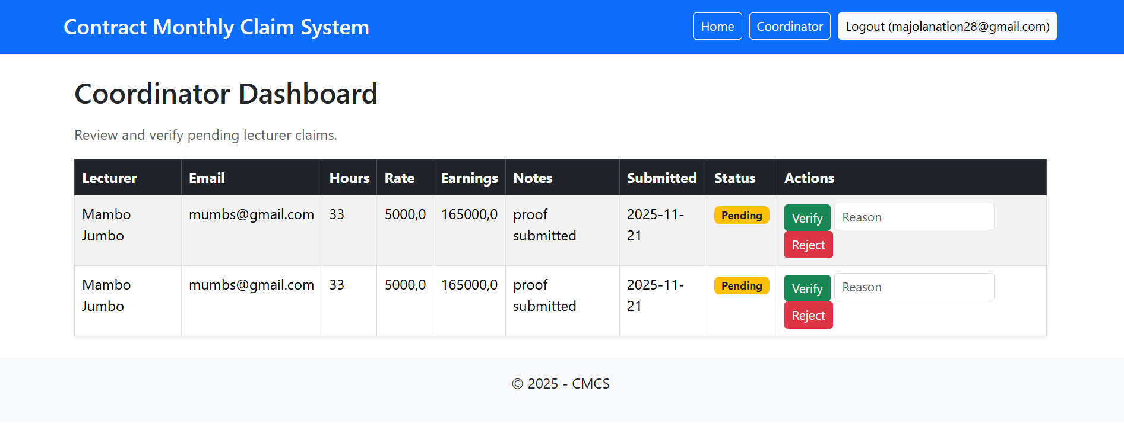

Slide 16
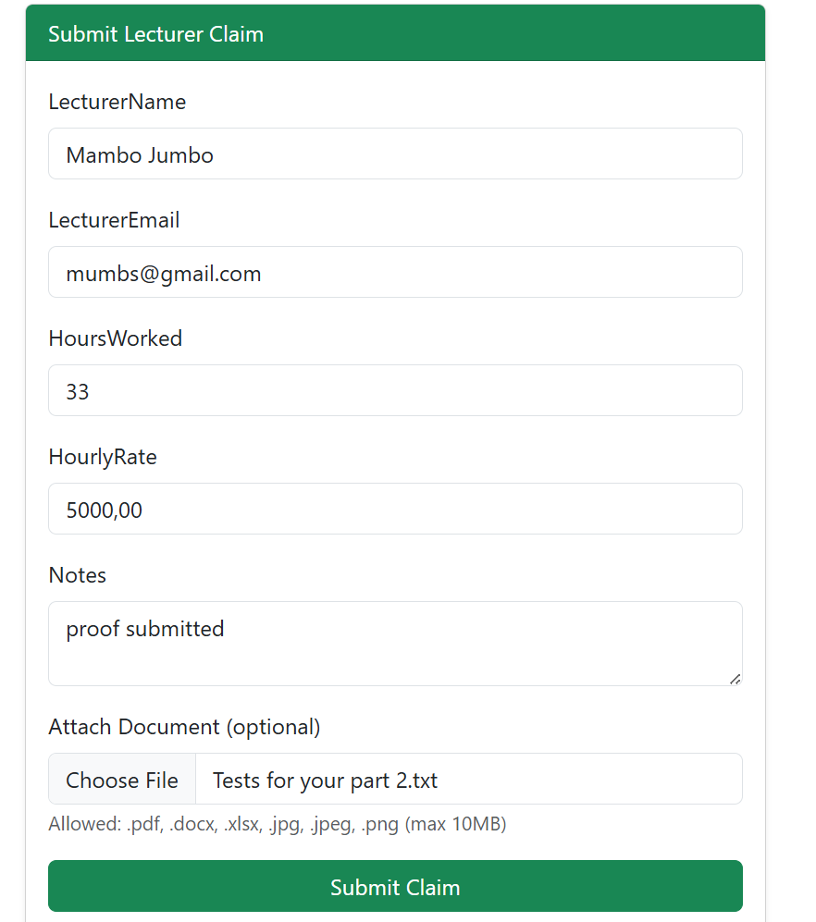
Notes:
Document successfully added to claim .

Slide 17
Coordinator dashboard
Purpose: View pending claims; verify or reject with comments.
Scope: Only pending claims; clean list with essential info and document links.

Slide 18
Notes:
Pending, approving, and rejection actions available for Coordinator

Slide 19
Manager Dashboard
Purpose: View verified claims; approve or decline with comments.
Scope: Only claims verified by coordinator.

Slide 20
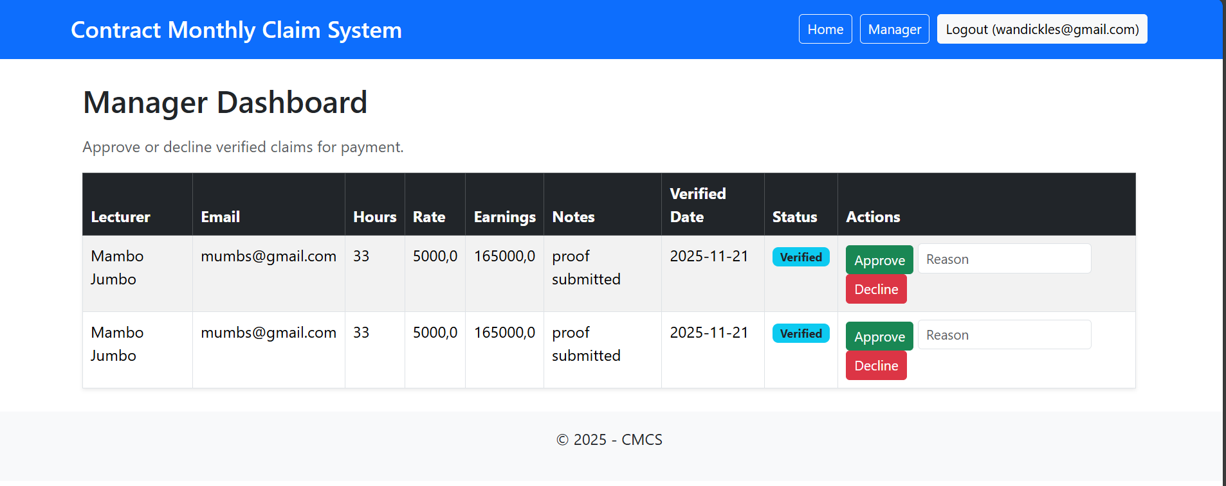
Notes:
Manager Dashboard and actions available

Slide 21
Review history and tracking
Transparency: Every status change captured with who, when, and comments.
Lecturer view: Claims show current status and history — accountability at each step.

Slide 22
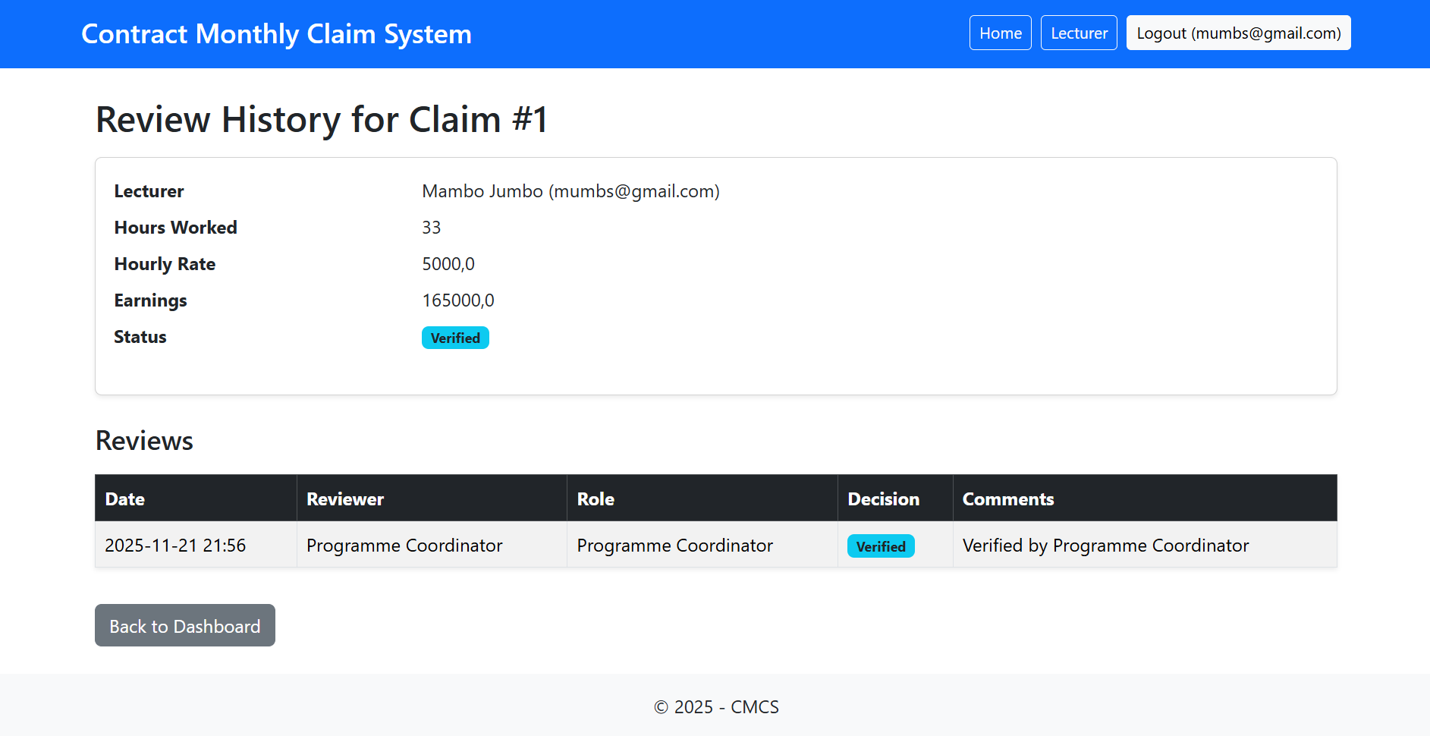

Slide 23
Automation Highlights
Lecturer automation: Auto-calc + validation + HR-sourced data.
Workflow automation: Role-based redirects; filtered dashboards; clean actions (verify/approve).
HR automation: One-click user lifecycle (create/edit/delete); default HR routing.

Slide 24
Notes:
Total payment auto calculated according to hours and rate

Slide 25
Conclusion
The Contract Monthly Claim System delivers one clear solution: lecturers submit, coordinators verify, managers approve, and HR manages users. Every role has its own dashboard, every claim is tracked with full history, and files are handled securely. The system replaces messy spreadsheets with automation, accountability, and transparency. It is efficient, reliable, and ready for real workflows.

